Slide 1
Background
Traditional programming is serial
Parallel programming
  Break processing into parts that can be executed concurrently on multiple processors
Challenge
  Identify tasks that can run concurrently
and/or groups of data that can be processed concurrently
  Not all problems can be parallelized

Slide 2
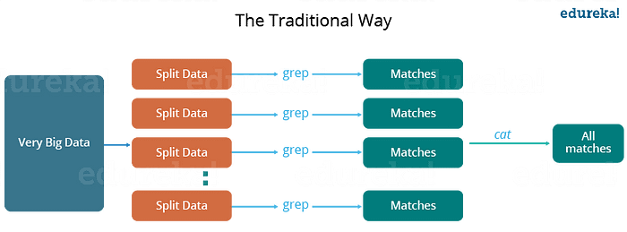
Motivation

Slide 3
Big Data
it cannot be stored in one machine
store the data sets on multiple machines
Google File System
it cannot be processed in one machine
parallelize computation on multiple machines
MapReduce

Slide 4
Motivation: Large Scale Data Processing
Want to process lots of data ( > 1 TB)
Want to parallelize across hundreds/thousands of CPUs
Want to make this easy

Slide 5
Motivation: Example
Carnegie Mellon
Processing Web Data on a Single Machine
  20+ billion web pages x 20KB = 400+ terabytes
  One computer can read 30‐35 MB/sec from disk
  ~ four months to read the web
  ~1,000 hard drives just to store the web
  Even more to do something with the data
Takes too long on a single machine, but with 1000 machines?
  < 3 hours to perform on 1000 machines
  But how long to program? What about the overheads?
  Communication, coordination, recovery from machine failure
  Status Reporting, Debugging, Optimization, Locality

Slide 6
The Map-Reduce Framework
Google published MapReduce 2004, a year after the Google File System
A high level programming paradigm
  allows many important data-oriented processes to be written simply
processes large data by:
  applying a function to each logical record in the input (map)
  categorize and combine the intermediate results into summary values (reduce)

Slide 7
Where does Google use MapReduce?
Input
crawled documents
web request logs
MapReduce
inverted indices
graph structure of web documents
summaries of the number of pages crawled per host
the set of most frequent queries in a day
Output

Slide 8
Storage Model
Data is stored in large files (TB, PB)
  e.g., market-basket data (more when we do data mining)
  or web data
Files are divided into chunks
  Typically, many MB (64 MB)
  sometimes each chunk is replicated for fault tolerance

Slide 9
MapReduce
MapReduce
  Framework for parallel computing
  Programmers get simple API
  Don’t have to worry about handling
    parallelization
    data distribution
    load balancing
    fault tolerance
Allows to process huge amounts of data (terabytes and petabytes) on thousands of processors

Slide 10
Who has it?
Google
  Original proprietary implementation
Apache Hadoop MapReduce
  Most common (open-source) implementation
  Built to specs defined by Google
Amazon Elastic MapReduce
  Uses Hadoop MapReduce running on Amazon EC2
… or Microsoft Azure HDInsight
… or Google Cloud MapReduce for App Engine

Slide 11
MapReduce Features
Automatic parallelization & distribution
Fault-tolerant
Provides status and monitoring tools
Clean abstraction for programmers

Slide 12
MapReduce Working
Map
Grab the relevant data from the source
User function gets called for each chunk of input
Spits out (key, value) pairs
Reduce
Aggregate the results
User function gets called for each unique key with all values corresponding to that key

Slide 13
MapReduce Working
Map: (input data) → intermediate(key/value pairs)
Reduce: intermediate(key/value pairs) → result files

Slide 14


MapReduce Working
Map
  Grab the relevant data from the source (parse into key, value)
  Write it to an intermediate file
Partition
  Partitioning: identify which of R reducers will handle which keys
  Map partitions data to target it to one of R Reduce workers based on a partitioning function (both R and partitioning function user defined)
Shuffle & Sort
  Shuffle: Fetch the relevant partition of the output from all mappers
  Sort by keys (different mappers may have sent data with the same key)
Reduce
  Input is the sorted output of mappers
  Call the user Reduce function per key with the list of values for that key to aggregate the results
Map Worker
Reduce Worker

Slide 15
Map
Records from the data source (lines out of files, rows of a database, etc) are fed into the map function as key*value pairs: e.g., (filename, line).
map() produces one or more intermediate values along with an output key from the input.

Slide 16
Map
map (in_key, in_value) -> (out_key, intermediate_value)
list

Slide 17
Reduce
After the Map phase is over, all the intermediate values for a given output key are combined into a list
reduce() combines those intermediate values into one or more final values for that same output key
In practice, usually only one final value per key

Slide 18


Reduce
reduce (out_key, intermediate_value list) -> out_value list

Slide 19
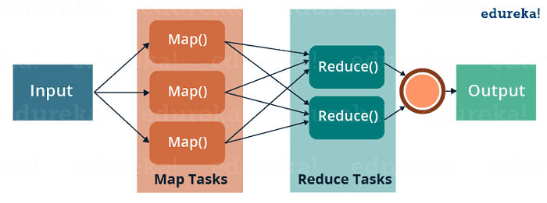

Slide 20
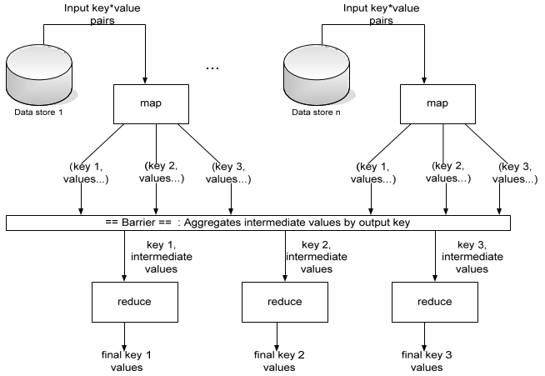
MapReduce Working

Slide 21
Parallelism
map() functions run in parallel, creating different intermediate values from different input data sets
  The programmer must specify a proper input split (chunk) between mappers to enable parallelism
reduce() functions also run in parallel, each working on a different output key
  Number of reducers is a key parameter which determines MapReduce performance
All values are processed independently
Bottleneck: reduce phase can’t start until map phase is finished.

Slide 22
Data Locality
Master program divides up tasks based on location of data
  Tries to have map() tasks on same machine as physical file data, or at least same rack
map() task inputs are divided into 64 MB blocks same size as Google File System chunks

Slide 23
Handling Fault Tolerance
Although the probability of a machine failure is low, the probability of a machine failing among thousands of machines is common
Worker Failure
  The master sends heartbeat to each worker node
  If a worker node fails, the master reschedules the tasks handled by the worker
Master Failure
  The whole MapReduce job gets restarted through a different master

Slide 24
Optimizations
No reduce can start until map is complete:
  A single slow disk controller can rate-limit the whole process
Master redundantly executes “slow-moving” map tasks; uses results of first copy to finish

Slide 25





















































MapReduce: the complete picture
client
master
forks
Shard 0
Assign tasks
Shard 1
Map worker
IF
Output file 1
Reduce worker
Shard 2
Shard 3
Map worker
IF
…
Reduce worker
Output file 2
Map worker
IF
Shard M-1
R work items
M work items
Intermediate files
MAP
SHUFFLE
REDUCE

Slide 26
Why is Map-Reduce Popular?
Distributed computation before MapReduce
  how to divide the workload among multiple machines?
  how to distribute data and program to other machines?
  how to schedule tasks?
  what happens if a task fails while running?
  … and … and ...
Distributed computation after MapReduce
  how to write Map function?
  how to write Reduce function?
Developers’ tasks made easy

Slide 27
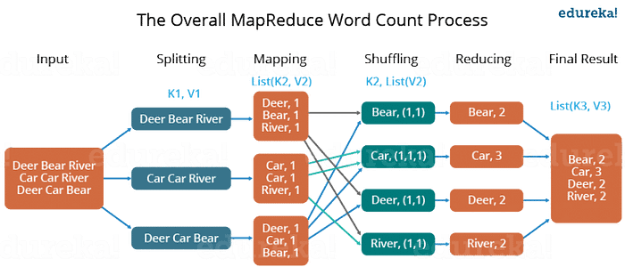
Example
Dear, Bear, River, Car, Car, River, Deer, Car and Bear

